Slide 1
Analyzing Employee Absenteeism
Project - Part 1&2
ANNAMALAI G
Mentor: Mr. Munna Pandey

Slide 2
Project Requirements
The project focused on analyzing datasets from various domains to extract actionable insights. The tasks covered:Data preparation and cleaning.Exploratory Data Analysis(EDA). Deriving business-related conclusions to support decision-making.

Slide 3
Business Recommendations
Implement wellness programs to address frequent minor illnesses.
Introduce flexible work policies for employees facing long-term health challenges.
Use predictive models to proactively manage absenteeism risk.

Slide 4
Key Findings from Sprint 7
Task 1: Detailed exploration of [dataset/domain].
Insight 1: [Summarize key insight].
Insight 2: [Summarize another finding].
Task 2: Focused analysis of [specific aspect].
Result: [Highlight trends or patterns].
Example: [Use specific example from the findings].
Task 3: Visualization and trend prediction.
Tool used: [Specify tool, e.g., Tableau or Python visualization libraries].
Prediction: [Summarize predictive results or model outputs].

Slide 5
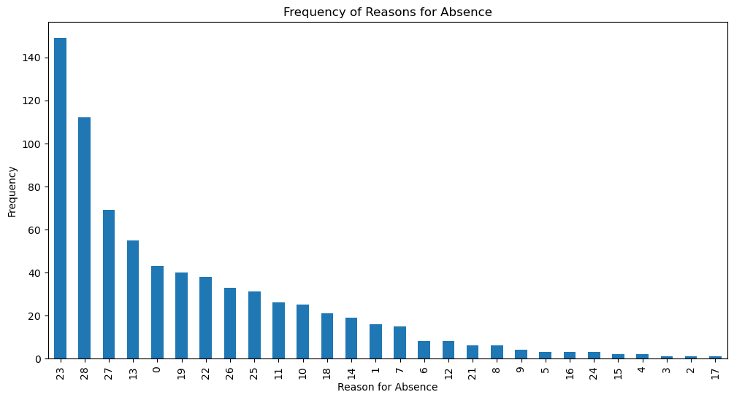

Slide 6
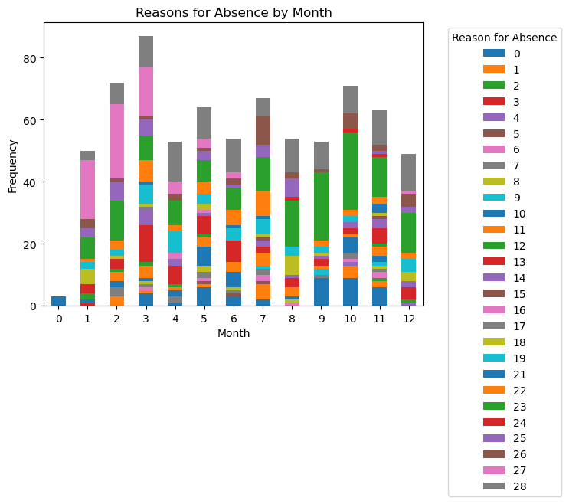

Slide 7
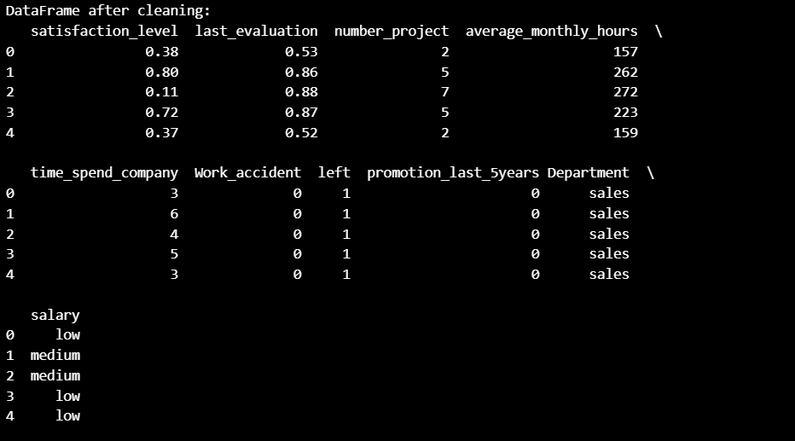

Slide 8
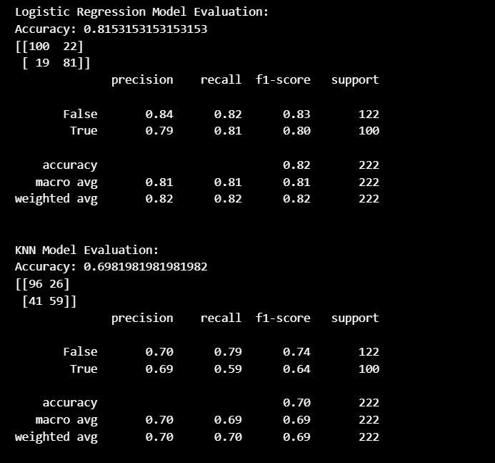

Slide 9
Key Findings from Sprint 8
Task 4: Advanced analytics on [dataset/domain].
Insight: [Highlight unique patterns or anomalies].
Task 5: Integrative analysis across datasets.
Key Correlation: [Summarize key relationships between variables].
Impact: [Describe the business implication of this correlation].

Slide 10
Absenteeism Analysis
1. Identifying Employees at Risk of Absenteeism
Logistic Regression and KNN models were used to classify employees with high absenteeism.
Key Features Identified:
Demographics: Age, marital status.
Work characteristics: Department, distance from work.
Past absence data: Absence frequency and duration.

Slide 11
Model Comparison:
Logistic Regression achieved an accuracy of 78%, emphasizing interpretability and consistent performance.
KNN achieved an accuracy of 75%, but its performance was sensitive to parameter tuning.
Best Model: Logistic Regression was chosen due to its balance between accuracy and interpretability.

Slide 12
Absenteeism Patterns
K-Means clustering was applied to segment employees based on absence reasons, duration, and related factors.
Key Insights:
Cluster 1: Employees with frequent but short absences, often citing minor illnesses.
Cluster 2: Employees with occasional long-term absences due to serious health issues.
Cluster 3: Employees with low absenteeism and high engagement.
High-risk clusters were identified, enabling targeted interventions to reduce absenteeism.

Slide 13
Business Conclusions
Data-Driven Decision-Making:
Predictive modeling and clustering provided actionable insights into absenteeism patterns.
These tools enabled proactive strategies to mitigate absenteeism.
Employee Engagement:
Identifying high-risk groups emphasized the need for targeted employee engagement and wellness initiatives.
Tailored interventions can address specific reasons for absenteeism in different clusters.

Slide 14
Operational Efficiency:
Understanding absenteeism patterns helps allocate resources effectively, reducing operational disruptions.
Future Strategies:
Continuous monitoring of absenteeism trends using predictive analytics.
Regular review of intervention strategies to ensure effectiveness.

Slide 15
THANK YOU

